Slide 1
How to obtain Hedera Testnet credential / resources ( test HBAR)

Slide 2
https://portal.hedera.com/login

Slide 3
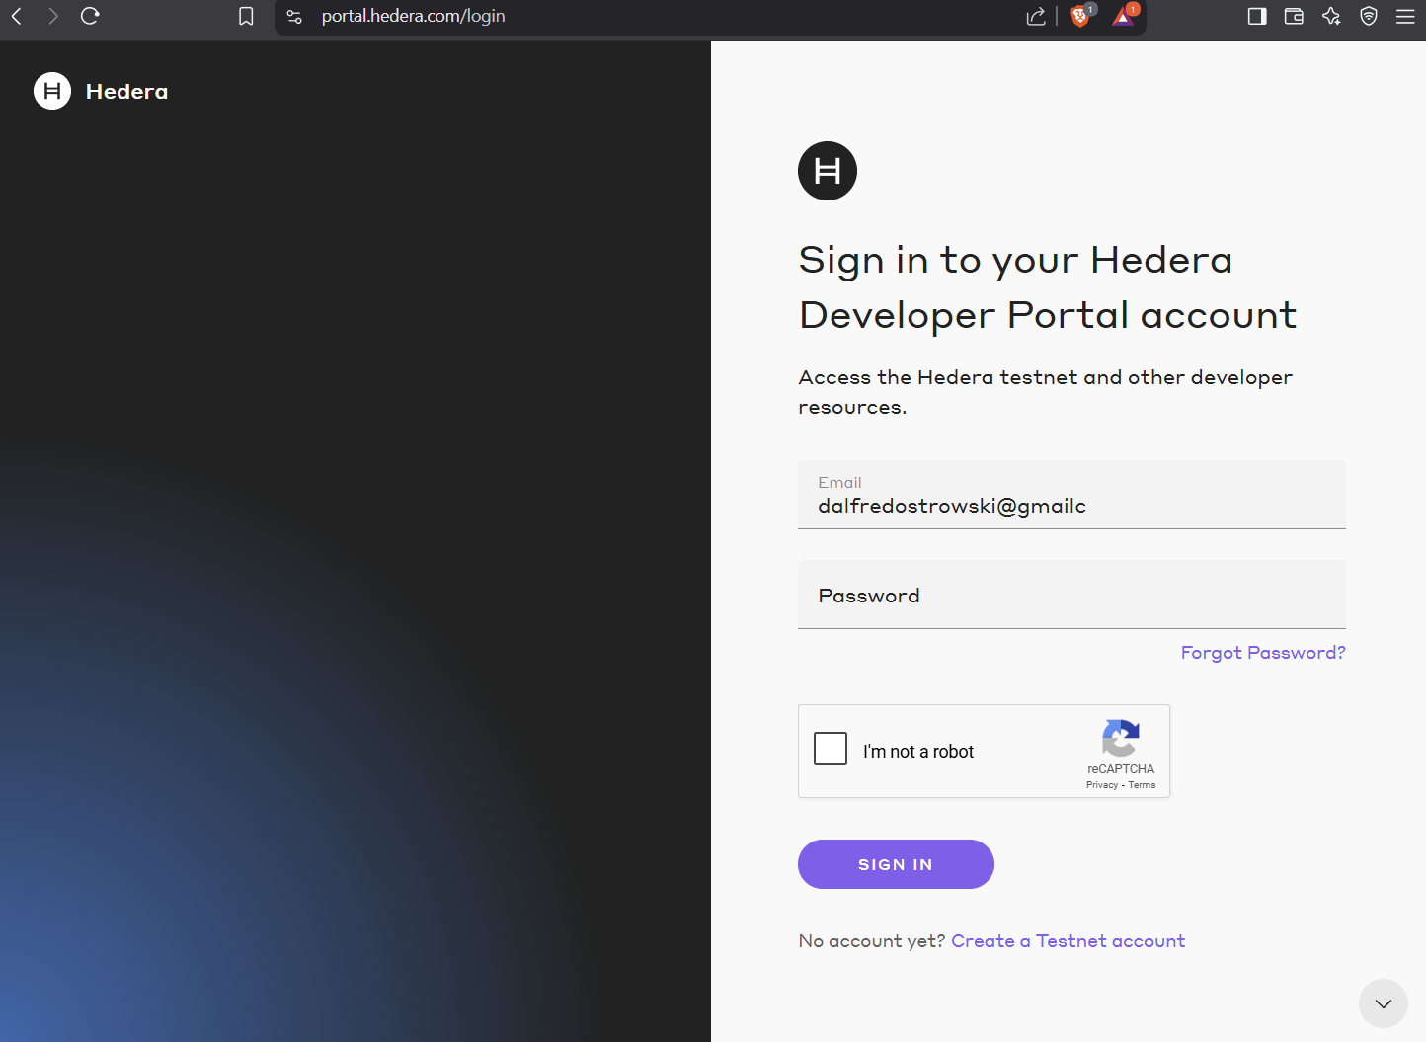

Slide 4
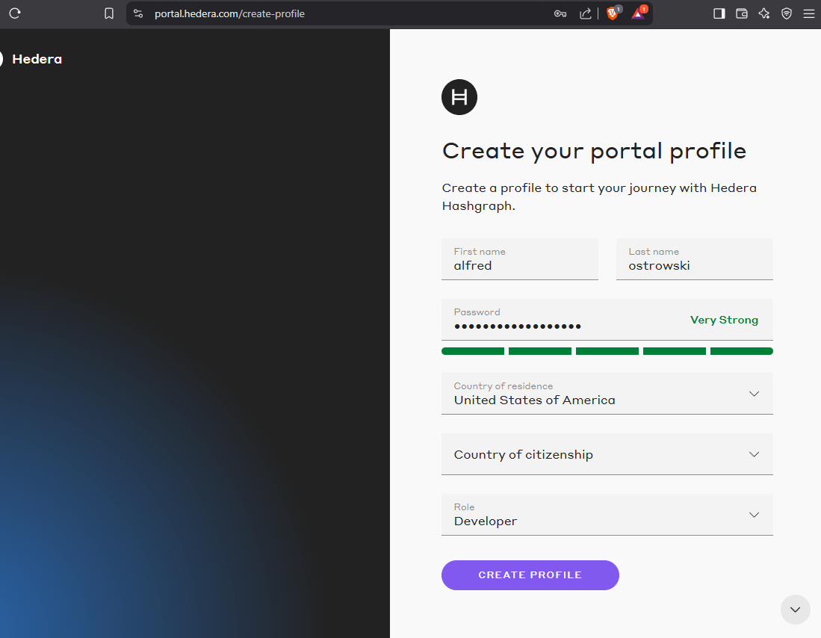

Slide 5
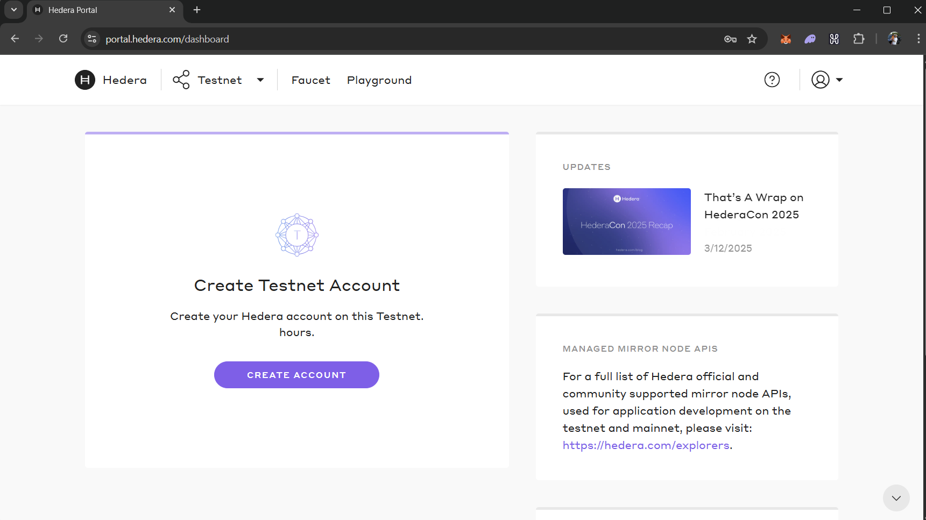

Slide 6
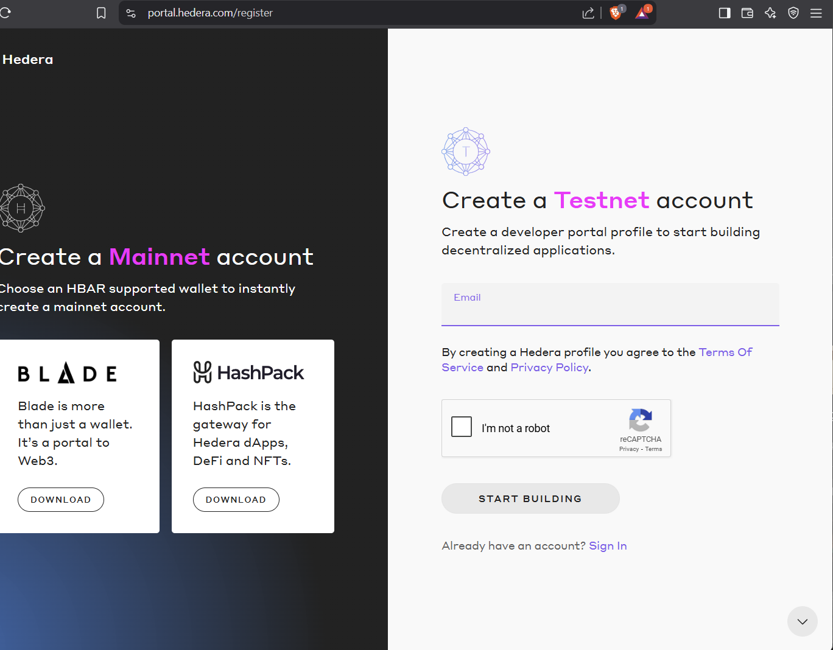

Slide 7
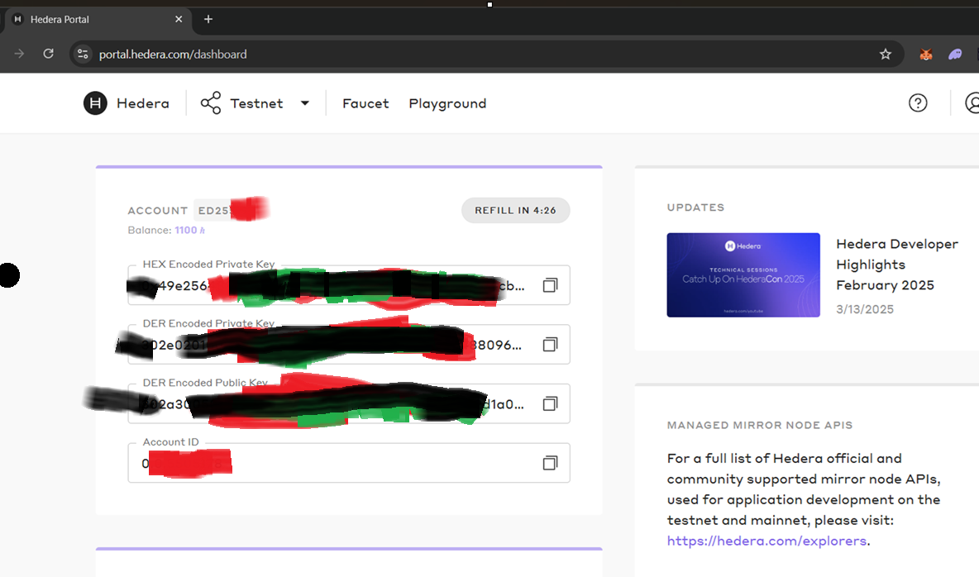

Slide 8
